Slide 1


THE “යං” (YĀN) TRAVEL APP

Slide 2

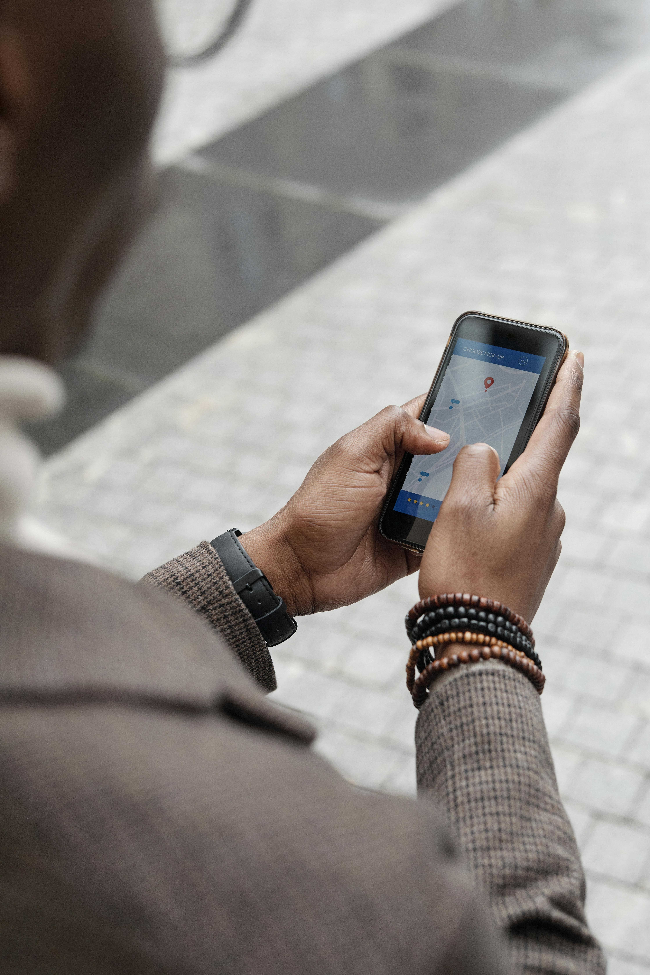
INTRODUCTION
Overview
Key features
Future improvements
Kavya Samaraweera- 10899353

Slide 3

FEATURES
User-Friendly Interface
Booking and Reservation System
Offline Access and Travel Resources
Customer Support and Assistance
Sajana Liyanage- 10899416

Slide 4
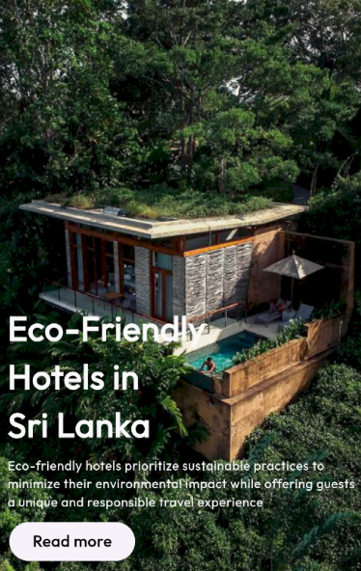
Design and User Experience (UX/UI)
User Research
Wireframes and Prototypes
Usability Testing
Interaction Design
Munasingha Jayasingha- 10898788

Slide 5
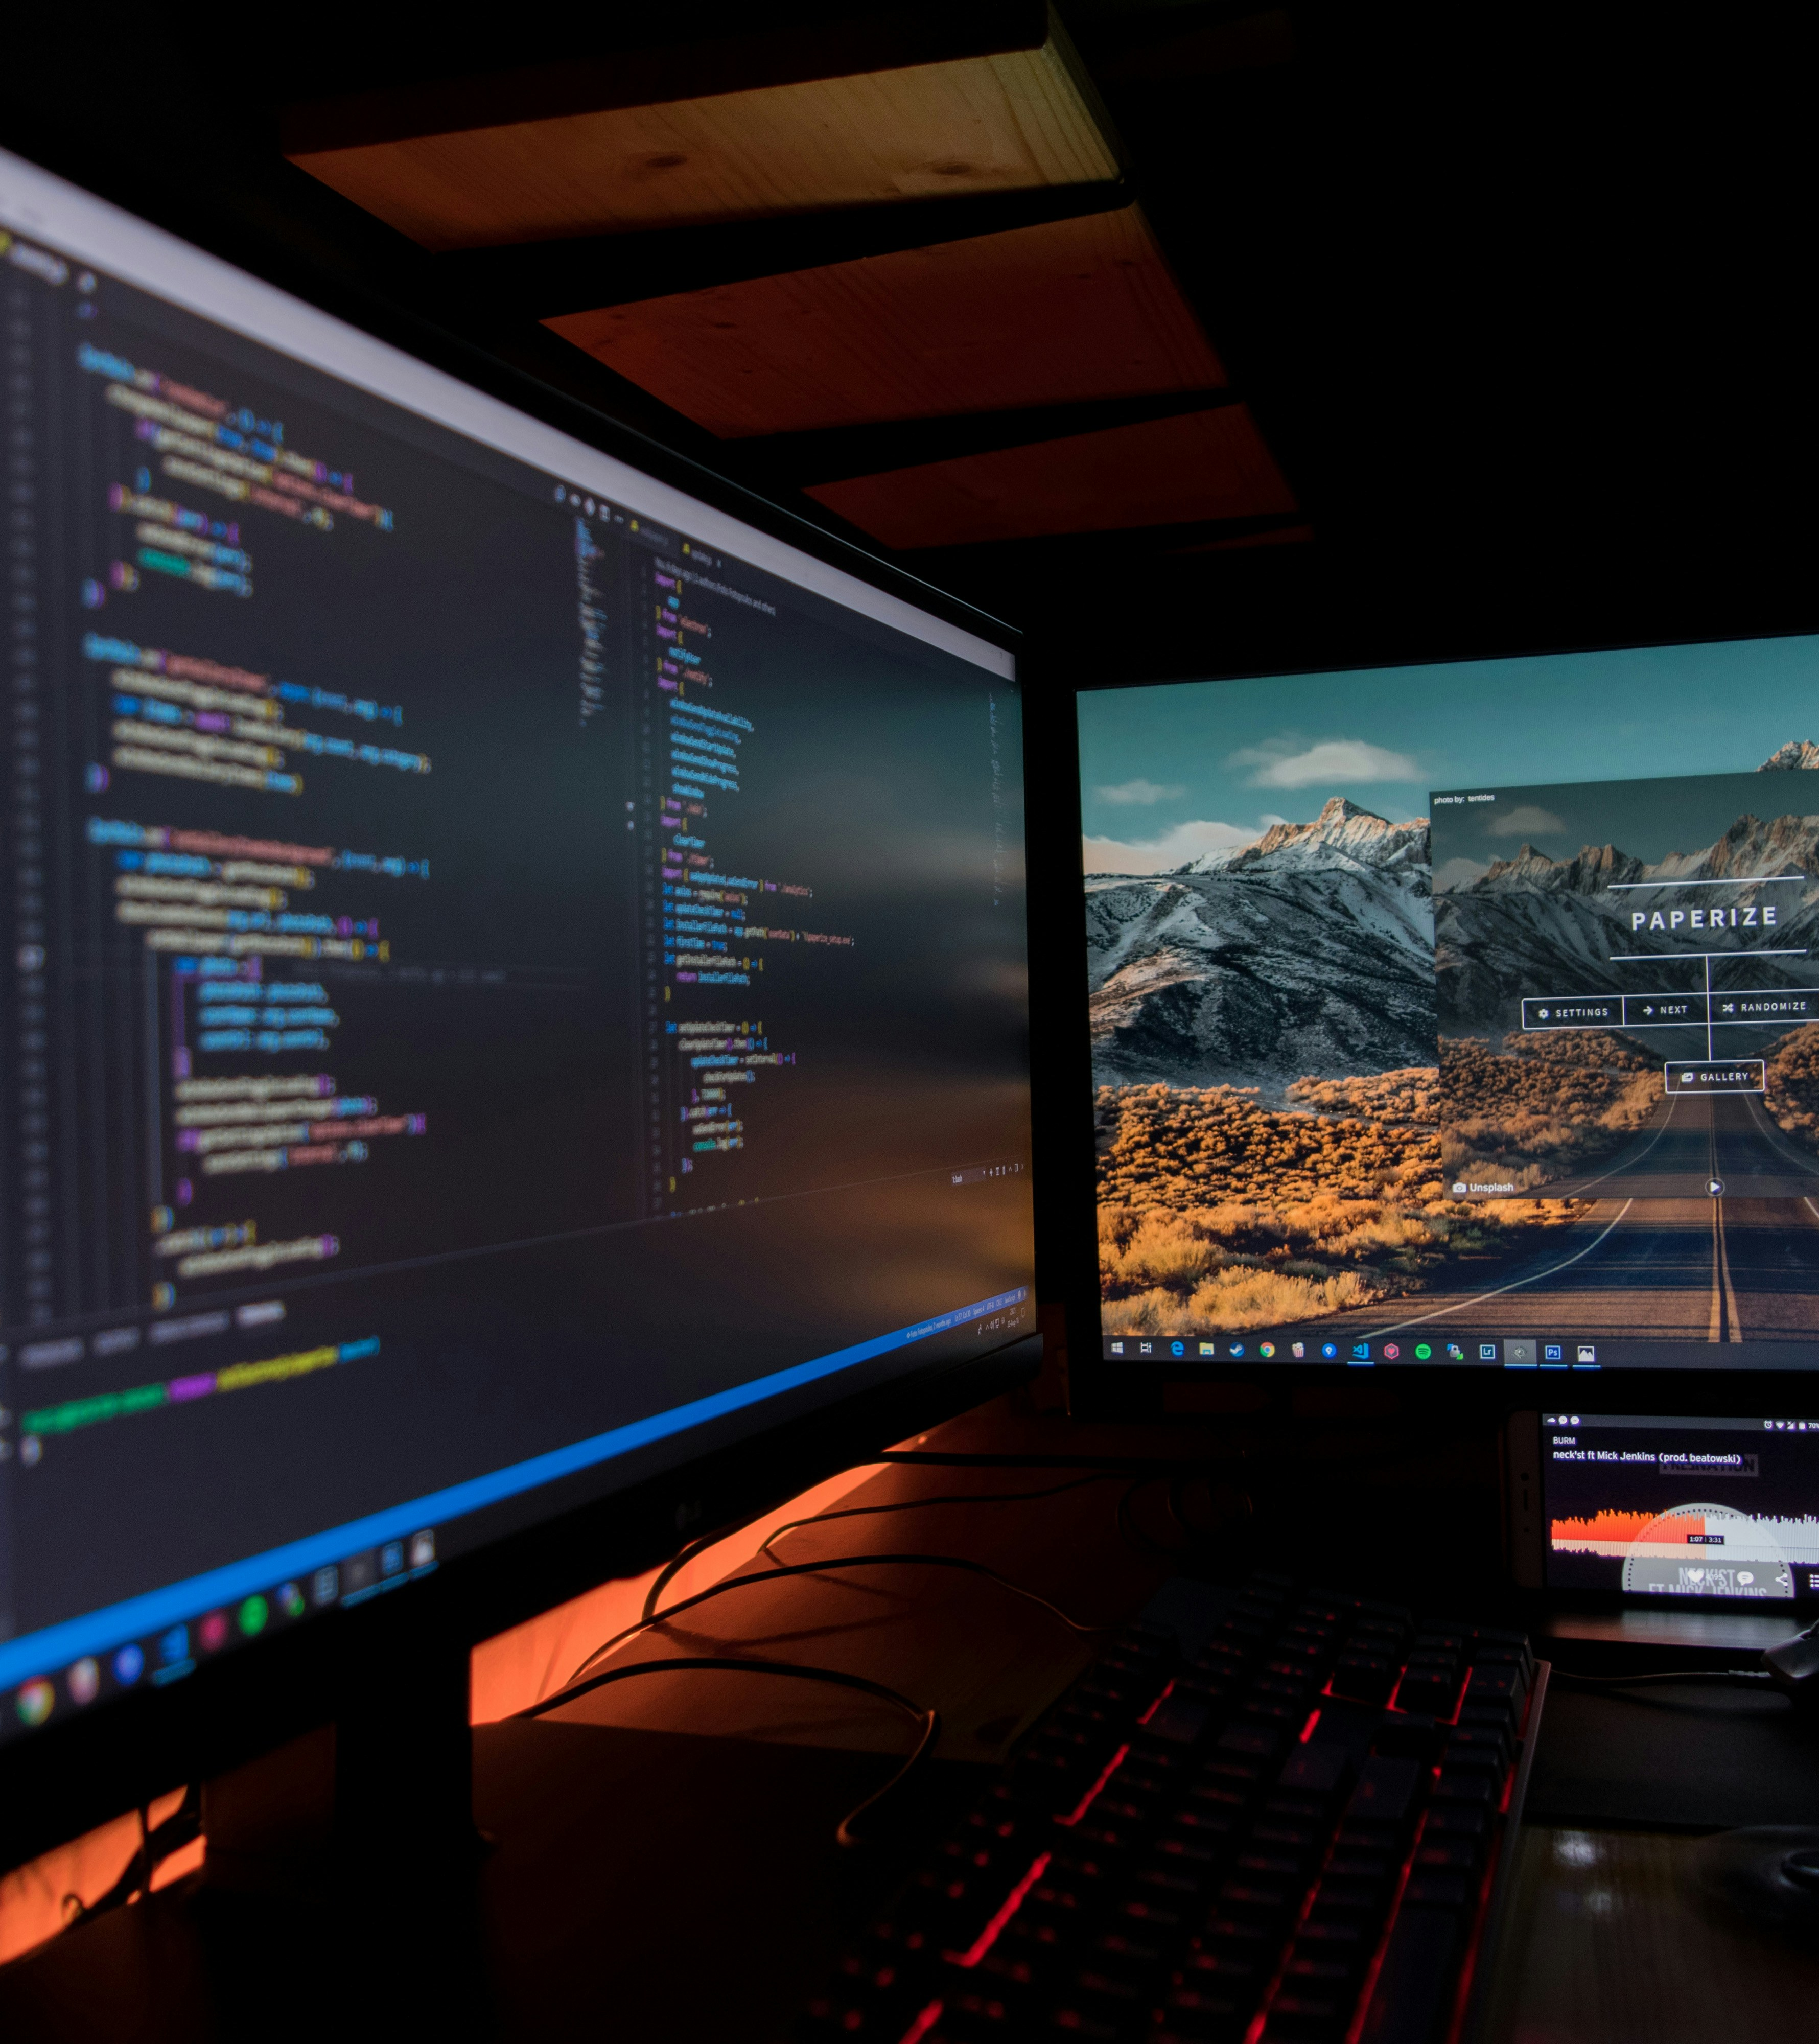
DEVELOPMENT PROCESS
Development Environment Setup
Frontend Development
Backend Development
Kurukude Perera- 10899339

Slide 6

Testing and Quality Assurance
Functional Testing
Compatibility Testing
Usability Testing
Performance Testing
Kasun Karunanayaka- 10899413

Slide 7
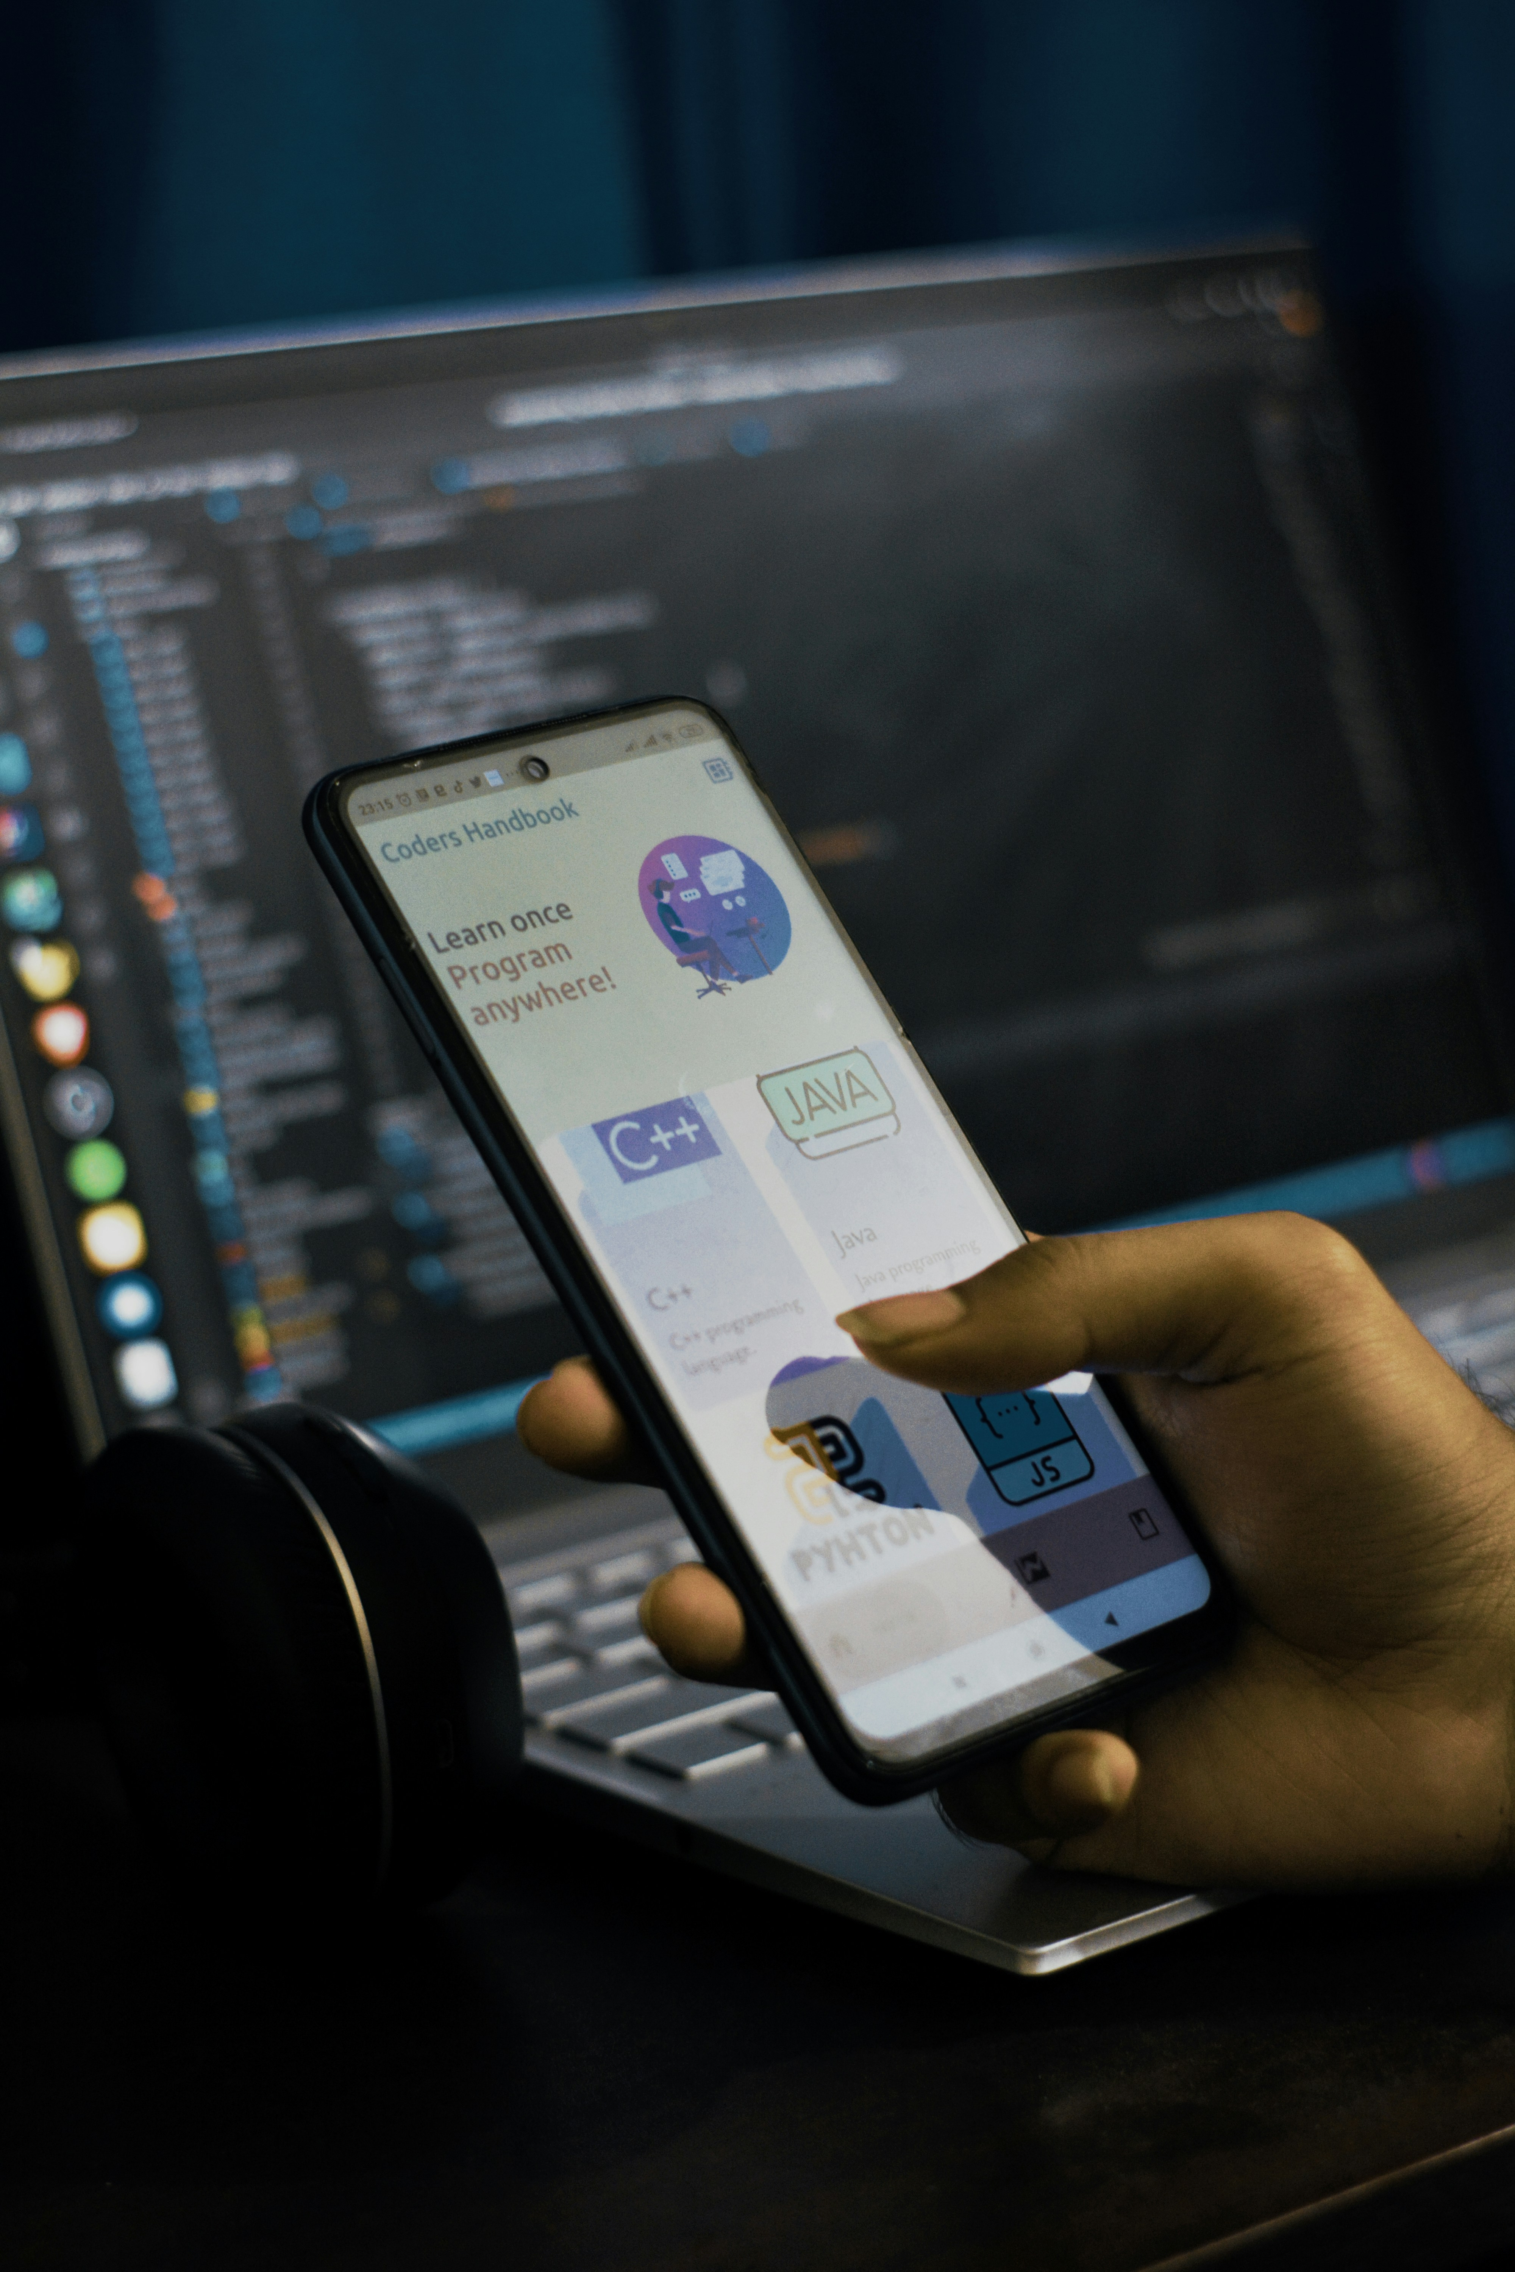
Conclusion
In conclusion, the development journey of our travel app embodies meticulous planning, innovative design, and rigorous testing. With its intuitive interface, personalized recommendations, and seamless booking features, the app promises to revolutionize travel experiences. We're excited about its potential impact on users, the market, and the business, poised for future growth and success.
Senevirathne Kulatunge- 10898800

Slide 8

THANK YOU

